Slide 1
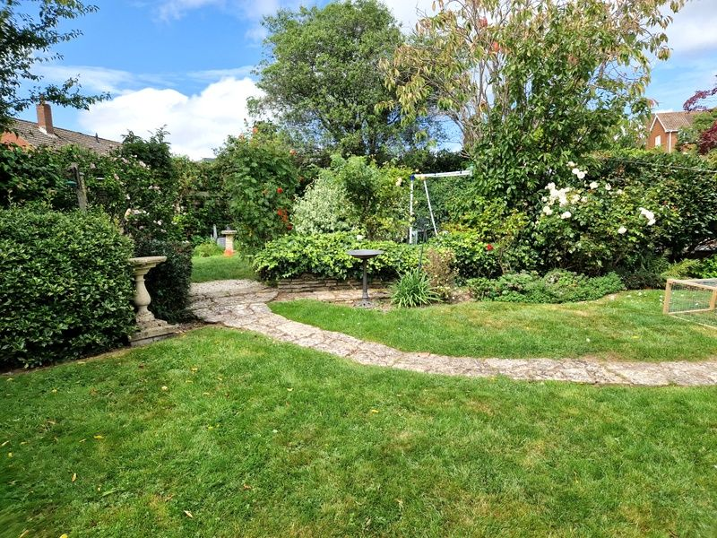
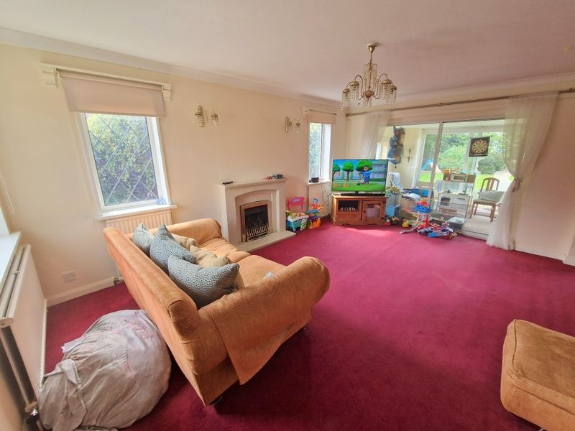
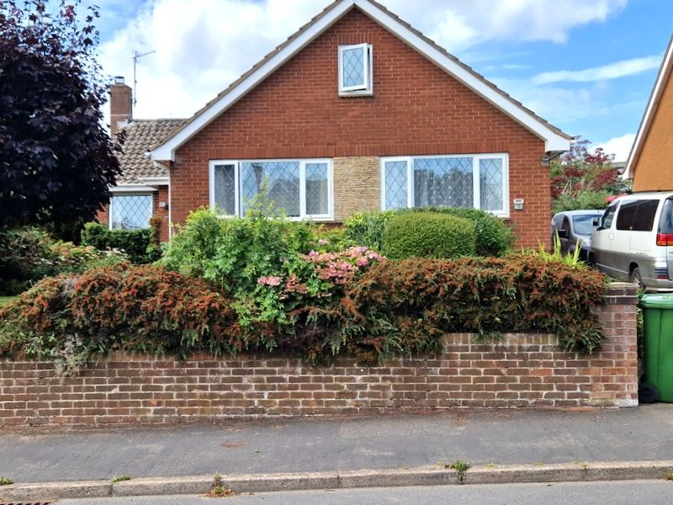
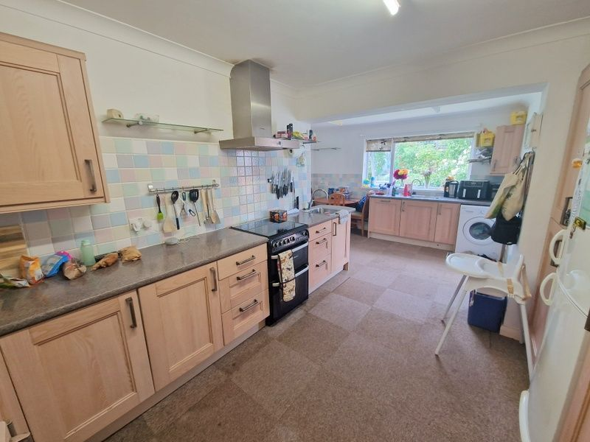
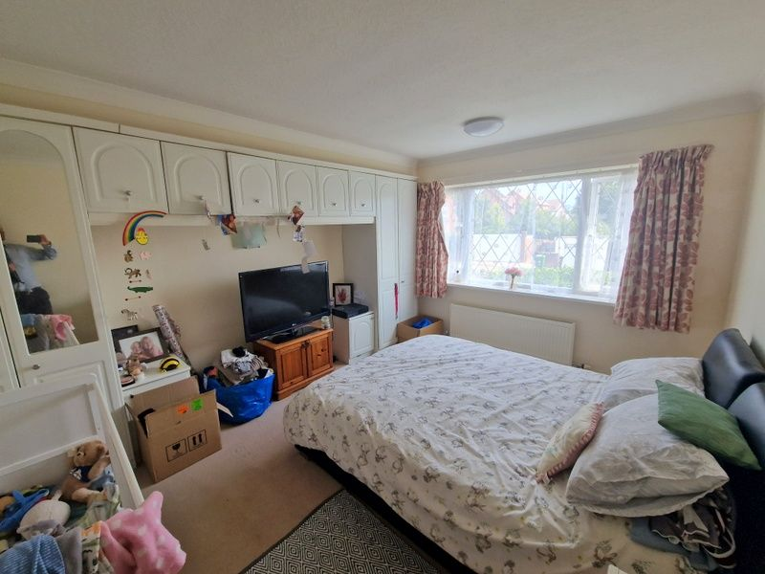
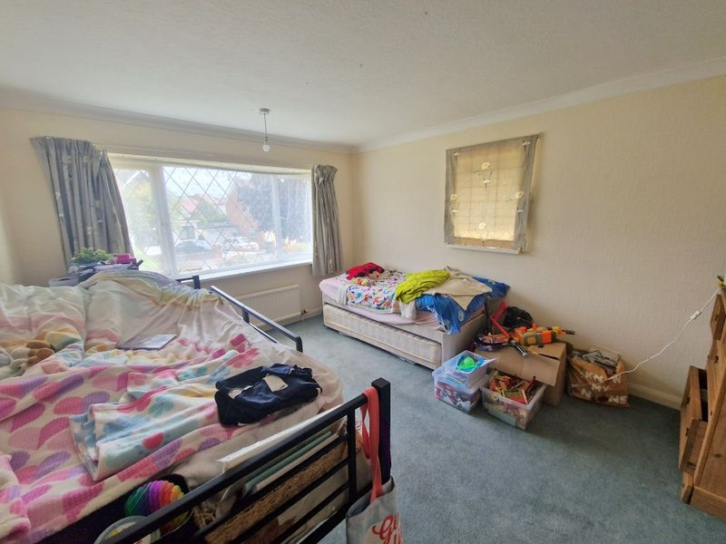
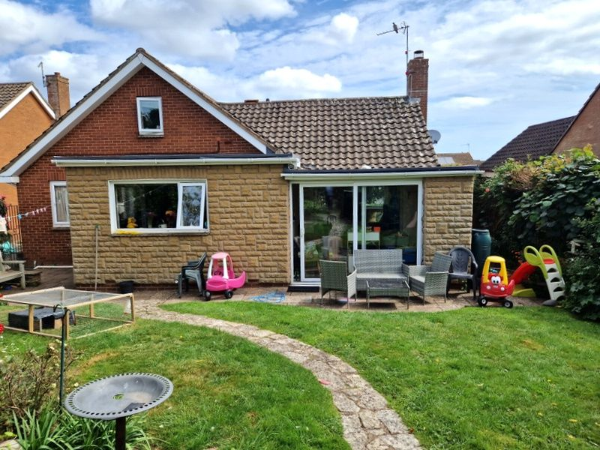
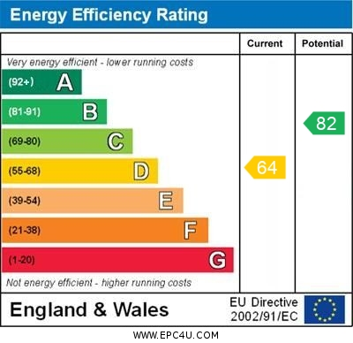
www.pennys.net
73 Douglas Avenue, Exmouth, EX8 2HG
GUIDE PRICE £625,000
TENURE Freehold
Deceptively Spacious Detached Chalet Style Bungalow Situated In Favoured Avenues Area Of Exmouth
Lounge * Study Area * Sun Room * Kitchen/Breakfast Room * Three Ground Floor Bedrooms * Ground Floor Shower Room * Spacious First Floor Bedroom And First Floor Modern Bathroom Suite * Attractive Front And Rear Gardens * Driveway * Garage
Pennys Estate Agents Limited for themselves and for the vendor of this property whose agents they are give notice that:- (1) These particulars do not constitute any part of an offer or a contract. (2) All statements contained in these particulars are made without responsibility on the part of Pennys Estate Agents Limited. (3) None of the statements contained in these particulars are to be relied upon as a statement or representation of fact. (4) Any intending purchaser must satisfy himself/herself by inspection or otherwise as to the correctness of each of the statements contained in these particulars. (5) The vendor does not make or give and neither do Pennys Estate Agents Limited nor any person in their employment has any authority to make or give any representation or warranty whatever in relation to this property.
PENNYS ESTATE AGENTS
2 Rolle House, Rolle Street, Exmouth, Devon, EX8 2SN
Tel: 01395 264111 EMail: help@pennys.net

Slide 2
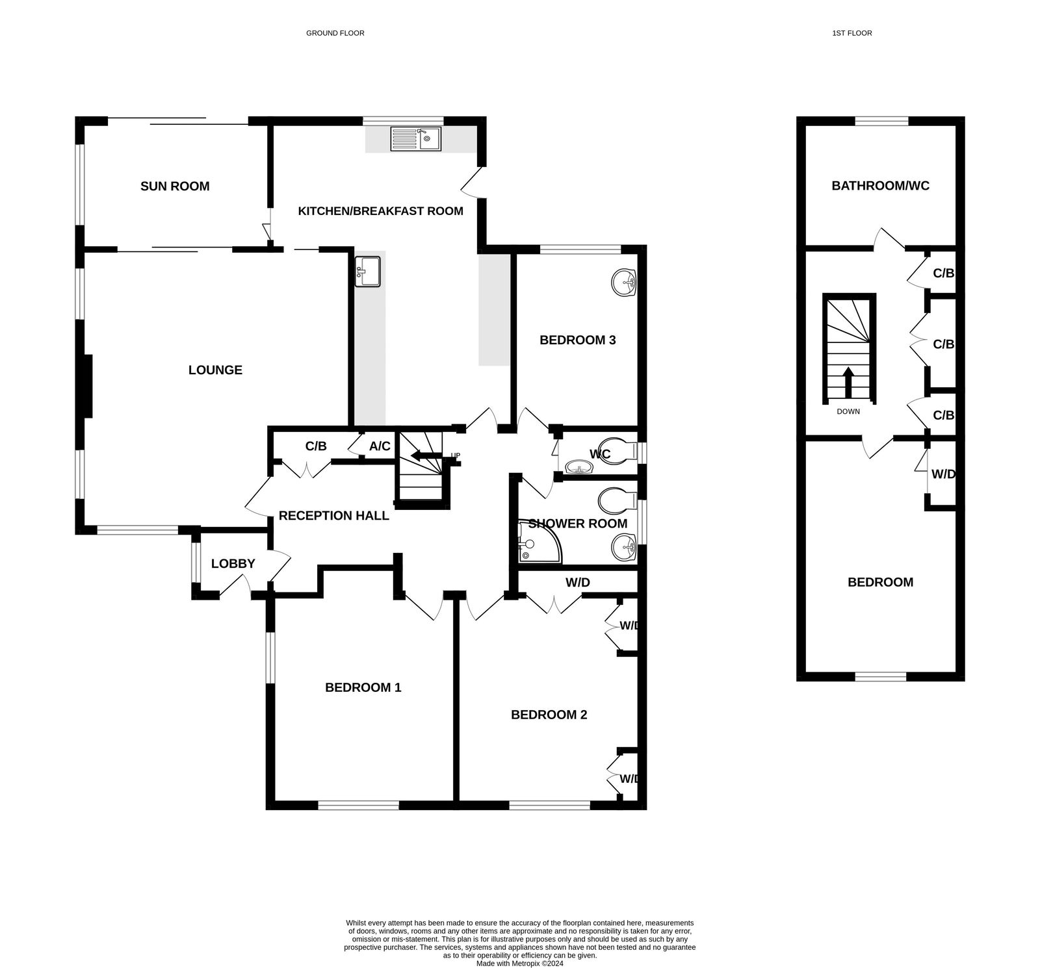
73 Douglas Avenue, Exmouth, EX8 2HG
THE ACCOMMODATION COMPRISES: Front door giving access to:
ENTRANCE LOBBY: Window to side elevation, part glazed door to:
RECEPTION HALL: Walk in storage cupboard, radiator, archway to:
INNER HALLWAY: Telephone point, stairs rising to FIRST FLOOR With a linen cupboard halfway up housing gas boiler.
LOUNGE: 5.23m x 3.61m (17'2" x 11'10") A bright triple aspect room with marble fireplace with fitted gas fire, three radiators, TV point, sliding patio doors to:
SUN ROOM: 3.35m x 2.44m (11'0" x 8'0") With window to side elevation plus patio doors overlooking and leading to the rear garden.
STUDY AREA: 3.3m x 1.4m (10'10" x 4'7") Accessed via square opening from the lounge, radiator, door to:
KITCHEN/BREAKFAST ROOM: 6.05m x 4.01m (19'10" x 13'2") narrowing to 3m (9'10") With window overlooking the rear garden, fitted range of work surfaces with inset stainless steel sink unit with mixer tap, extensive range of light wood fronted base and high level cupboards, including carousel corner unit and pull out tall larder cupboard, gas cooker point with filter extractor hood over, plumbing for automatic washing machine, integrated dishwasher, space for upright fridge/freezer.
GROUND FLOOR BEDROOM 1: 4.27m x 3.51m (14'0" x 11'6") Window overlooking front garden, radiator, TV point, range of built-in wardrobes.
GROUND FLOOR BEDROOM 2: 4.27m x 3.51m (14'0" x 11'6") With double glazed windows, radiator, arched recess.
GROUND FLOOR BEDROOM 3: 3.3m x 2.39m (10'10" x 7'10") Overlooking the rear garden, radiator, wash hand basin.
SHOWER ROOM: 2.39m x 1.6m (7'10" x 5'3") With tiled walls, obscure window, glazed corner shower cubicle with fitted shower unit, extractor/light fitting, pedestal wash hand basin, WC, radiator, tiled flooring.
SEPARATE WC: With obscure window, part tiled walls, wash hand basin, WC, tiled flooring.
FIRST FLOOR LANDING: Two cupboards.
BEDROOM 4: 4.5m x 3m (14'9" x 9'10") Sloping ceilings, front aspect window, built-in wardrobe, radiator.
FIRST FLOOR BATHROOM/WC: 3m x 2.39m (9'10" x 7'10") With modern suite comprising bath, pedestal wash hand basin, WC, part tiled walls, radiator.
OUTSIDE: Attractive lawned front garden edged with well stocked and colourful flower and shrub beds, paved pathway leading to front door, side access to the rear garden which is attractively planned and presented, laid to lawn with well stocked flower and shrub beds, lawned areas of gardens, seating areas, greenhouse, outside tap. Garage. To the front of the property there is also off road parking leading to:
GARAGE: 5.18m x 2.74m (17'0" x 9'0") With up and over door, power and light connected, and pedestrian side door connects into the garden.
Mortgage Assistance: We are pleased to recommend Meredith Morgan Taylor, who would be pleased to help no matter which estate agent you finally buy through. For a free initial chat please contact us on 01395 264111 to arrange an appointment. Your home may be repossessed if you do not keep up repayments on your mortgage. Meredith Morgan Taylor Ltd is an appointed representative of Openwork Limited, a trading style of Openwork Ltd which is authorised and regulated by the Financial Conduct Authority (FCA).
FLOOR PLAN:

